Slide 1
The Programming Historian Getting to know XML Cornelis J. (Kees-Jan) Schilt Sussex Humanities Lab, University of Sussex
October 19th , British Library, London

Slide 2
Introduction
Before we get started: google “TEI Boilerplate” or go to http://dcl.ils.indiana.edu/teibpws/, download the tei boilerplate code, and extract to desktop (or wherever, as long as you can retrieve it…)
(And if you have not yet done so, download Notepad++)
Digital history: some examples
A bit of thinking through text…
Introduce the concept of markup and XML encoding
Provide hands-on experience in using TEI XML markup

Slide 3
The wonderful world of digital history
Two notable projects:
The Newton Project: www.newtonproject.sussex.ac.uk & www.chymistry.org
Old Bailey Online: www.oldbaileyonline.org
What makes them tick?
A shitload of work
Javascript, HTML, …., but above all: XML
Tell me tell me tell me: what is it?

Slide 4
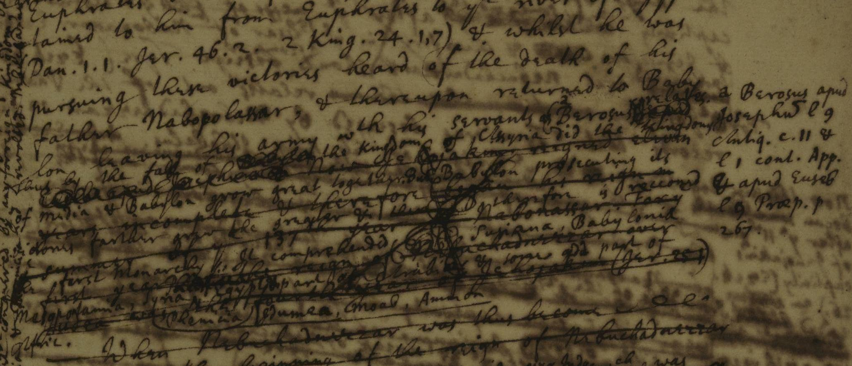
Front-end – back-end

Slide 5
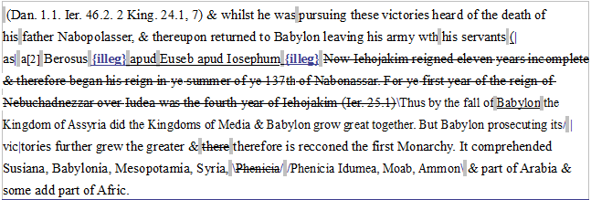
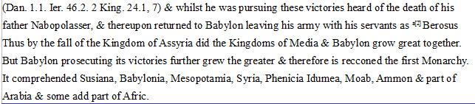
Front-end – back-end

Slide 6
Front-end – back-end: NP example
(Dan. 1.1. Ier. 46.2. 2 King. 24.1, 7) &amp; whilst he was <lb/>pursuing these victories heard of the death of his <lb/>father Nabopolasser, &amp; thereupon returned to Baby<lb/>lon leaving his army <choice><abbr>w<hi rend="superscript">th</hi></abbr><expan>with</expan></choice> his servants <del type="over">(</del><add indicator="no" place="over">as</add> <hi rend="superscript">a</hi><anchor xml:id="n004r-01"/><note target="#n004r-01" place="marginRight"><hi rend="superscript">a</hi><foreign xml:lang="lat">Berosus apud Ioseph<hi rend="overline">u</hi> l 9 Antiq. c. 11 &amp; l 1 cont. App. <del type="over">E</del><add indicator="no" place="over">&amp;</add> apud Euseb l <del type="over">c</del><add indicator="no" place="over">9</add> Præp. p 267.</foreign></note> <foreign xml:lang="lat">Berosus <del type="cancelled"><gap reason="illgblDel" unit="chars" extent="2"/> apud <lb/>Euseb apud Iosephum <gap reason="illgblDel" unit="chars" extent="3"/></del></foreign> <del type="strikethrough">Now Iehojakim reigned eleven <lb/>years incomplete &amp; therefore began his reign in <lb/><choice><abbr>y<hi rend="superscript">e</hi></abbr><expan>the</expan></choice> summer of <choice><abbr>y<hi rend="superscript">e</hi></abbr><expan>the</expan></choice> 137<hi rend="superscript">th</hi> of Nabonassar. For <choice><abbr>y<hi rend="superscript">e</hi></abbr><expan>the</expan></choice> <lb/>first year of the reign of Nebuchadnezzar over <lb/>Iudea was the fourth year of Iehojakim (Ier. 25.1)</del> <add indicator="no" place="supralinear infralinear">Thus by the fall of <del type="cancelled">Babylon</del> the Kingdom of Assyria did the Kingdoms of Media &amp; Babylon grow great together. But Babylon prosecuting its</add> <add place="lineBeginning" indicator="no">vic</add>tories further grew the greater &amp; <del type="strikethrough">there</del> therefore is recconed the first Monarchy. It comprehended Susiana, Babylonia, Mesopotamia, Syria, <add indicator="yes" place="supralinear"><del type="strikethrough">Phenicia</del></add> <add indicator="yes" place="infralinear">Phenicia Idumea, Moab, Ammon</add> &amp; part of Arabia &amp; some add part of Afric.</p>

Slide 7
Front-end – back-end: OB example
<persName id="t17231204-27-defend146" type="defendantName"> John Ward <interp inst="t17231204-27-defend146" type="surname" value="Ward"/> <interp inst="t17231204-27-defend146" type="given" value="John"/> <interp inst="t17231204-27-defend146" type="gender" value="male"/> </persName> , of <placeName id="t17231204-27-defloc147">Great Stanmore</placeName> <interp inst="t17231204-27-defloc147" type="placeName" value="Great Stanmore"/> <interp inst="t17231204-27-defloc147" type="type" value="defendantHome"/> <join result="persNamePlace" targOrder="Y" targets="t17231204-27-defend146 t17231204-27-defloc147"/>, was indicted for <rs id="t17231204-27-off148" type="offenceDescription"> <interp inst="t17231204-27-off148" type="offenceCategory" value="damage"/> <interp inst="t17231204-27-off148" type="offenceSubcategory" value="arson"/> feloniously setting Fire to a Barn of <persName id="t17231204-27-victim147" type="victimName"> Hezekiah Burr <interp inst="t17231204-27-victim147" type="surname" value="Burr"/> <interp inst="t17231204-27-victim147" type="given" value="Hezekiah"/> <interp inst="t17231204-27-victim147" type="gender" value="male"/> <join result="offenceVictim" targOrder="Y" targets="t17231204-27-off148 t17231204-27-victim147"/> </persName> , fill'd with Hay, Corn, &c. </rs> the <rs id="t17231204-27-cd149" type="crimeDate">18th of October</rs> <join result="offenceCrimeDate" targOrder="Y" targets="t17231204-27-off148 t17231204-27-cd149"/> last. The Prosecutor depos'd, his Barn was burned, with Hay, Corn, Peas, and Beans, and also five Horses were destroyed.

Slide 8
Textual Markup
In order to talk about texts, markup and encoding of texts, we need to understand what we mean by these basic concepts. When we talk about text encoding, what do we mean by a text? What is in a text and what assumptions do we make in reading them?

Slide 9
What’s in a text?

Slide 10
What’s in a text?

Slide 11
What’s in a text?

Slide 12
What’s in a text?

Slide 13
Are these images of the same thing?

Slide 14
A text is not a document
Where is the text?
In the shape of letters and their layout?
In the original from which the previous copy derives?
In the stories we read into it? Or in its author’s intentions?
A ”document” is something that exists in the world, a physical entity, which we can digitize.
A ”text” is an abstraction, created by or for a community of readers, which we can encode.

Slide 15
Encoding of texts
A text is more than a sequence of encoded glyphs or lexical tokens
It has a structure and a communicative function
It also has multiple possible readings
Encoding, or markup, is a way of making these things explicit
Meaning: encoding is subjective
Only that which is explicit can be reliably processed

Slide 16
What’s the point of markup?
To make explicit (to a machine) what is implicit (to a person)
To add value by supplying multiple annotations
To facilitate re-use of the same material
in different formats
in different contexts
by different users

Slide 17
Styles of markup
In the beginning there was procedural markup
1) RED INK ON 2)print #balance 3)RED INK OFF
which being generalised became descriptive markup
<balance type='overdrawn'>some numbers</balance>
also known as encoding or annotation
markup separate from text/data
descriptive markup allows for easier re-use of data

Slide 18
Just a little bit more…
Markup makes explicit the distinctions we want to make when processing a string of bytes
Markup is a way of naming and characterizing the parts of a text in a formalized way
It’s (usually) more useful to markup what we think things are than what they look like

Slide 19
Separation of form and content
Presentational markup cares more about fonts and layout than meaning
Descriptive markup says what things are, and leaves the rendition of them for a separate step
Separating the form of something from its content makes its re-use more flexible
It also allows easy changes of presentation across a large number of documents → think about Styles (Heading 1, Body, etc) in MS Word.

Slide 20
Markup as a scholarly activity
The application of markup to a document can be an intellectual activity
In deciding what markup to apply, and how this represents the original, one is undertaking the task of an editor
There is (almost) no such thing as neutral markup – all of it involves interpretation
Markup can assist in answering research questions, and the deciding what markup is needed to enable such questions to be answered can be a research activity in itself
Good textual encoding is never as easy or quick as people would believe
Detailed document analysis is needed before encoding for the resulting markup to be useful

Slide 21
Compare the markup

Slide 22
Compare the markup
<hi rend="dropcap">H</hi>&WYN;ÆT WE GARDE <lb/>na in
gear-dagum þeod-cyninga <lb/>þrym gefrunon, hu ða æþelingas
<lb/>ellen fremedon. oft scyld scefing sceaþe
<add>na</add>
<lb/>þreatum, moneg<expan>um</expan> mægþum meodo-setl
<add>a</add>
<lb/>of<damage>
<desc>blot</desc>
</damage>teah ...
<lg>
<l>Hwæt! we Gar-dena in gear-dagum</l>
<l>þeod-cyninga þrym gefrunon,</l>
<l>hu ða æþelingas ellen fremedon,</l>
</lg>
<lg>
<l>Oft Scyld Scefing sceaþena þreatum,</l>
<l>monegum mægþum meodo-setla ofteah;</l>
<l>egsode Eorle, syððan ærest wearþ</l>
<l>feasceaft funden...</l>
</lg>

Slide 23
A useful mental exercise
Imagine you are going to markup several thousand pages of complex material....
Which features are you going to markup?
Why are you choosing to markup this feature?
How reliably and consistently can you do this?
Now, imagine your budget has been halved. Repeat the exercise!

Slide 24
XML: eXtensible Markup Language
XML is structured data represented as strings of text
XML…
is extensible
must be well-formed
can be validated
XML is application-, platform-, and vendor- independent
It is one of the best plain text long-term preservation formats for textual data that we have
You use XML almost every day, never mind the web but in many devices

Slide 25
XML terminology
An XML document may contain:
elements, possibly bearing attributes
processing instructions
comments
entity references
namespaces
An XML document must be well-formed and may be valid

Slide 26
XML terminology Example
<?xml version="1.0" ?>
<root>
<element attribute="value"> content </element>
<!-- comment -->
</root>
<?xml version="1.0" ?>
<div>
<p rend="indent10">Hello world!</p>
<!– this is a sample xmlly -->
</root>

Slide 27
The rules of the XML game
An XML document represents a (kind of) tree
It has a single root and many nodes
Each node can be
a subtree
a single element (possibly bearing some attributes)
a string of character data
Each element has a name or generic identifier
XML elements and attributes are case sensitive

Slide 28
Representing an XML tree
An XML document is encoded as a linear string of characters
It begins with a special processing instruction
Element occurrences are marked by start and end-tags: <el>…</el>
The characters < and & are Magic and must always be ”escaped” using &lt; or &amp; if you want to use them as themselves
Comments are delimited by <!-- and -->
Attribute name/value pairs are supplied on the start-tag and may be given in any order: <add place=“above” hand=“#IN”> text </add>

Slide 29
Parts of an XML document
<?xml version="1.0"?>
<greetings xmlns="http://www.example.org/greetings">
<hello type="sarcastic">hello world!</hello></greetings>
The XML declaration
Namespace declarations
The root element of the document itself
Other elements and content
Attributes and values

Slide 30
The XML declaration
An XML document must begin with an XML declaration which does three things:
specifies that this is an XML document
specifies which version of the XML standard it follows
specifies which character encoding the document uses
<?xml version="1.0" ?>
<?xml version="1.0" encoding="iso-8859-1" ?>
The default, and recommended, encoding is ‘UTF-8’ (Unicode)

Slide 31
Namespace declarations
An XML namespace is a collection of element type and attribute names.
For instance: all TEI-XML documents are declared within the TEI namespace:
<TEI xmlns="http://www.tei-c.org/ns/1.0"> ...</TEI>
XML documents can include elements declared in different name spaces.
a namespace declaration associates a namespace prefix with an external URL-like identifier
the default namespace may be declared using a xmlns
other namespaces must all use a specially declared prefix
<TEI xmlns="http://www.tei-c.org/ns/1.0" xmlns:math="http://www.mathml.org"> <p>...<math:expr>...</math:expr>...</p>...</TEI>

Slide 32
The Tempest
<?xml version="1.0" encoding="utf-8" ?>
<TEI xmlns="http://www.tei-c.org/ns/1.0">
<div n="1">
<head>SCENE I. On a ship at sea: a tempestuous noise of thunder and lightning heard.</head>
<stage>Enter a Master and a Boatswain</stage>
<sp>
<speaker>Master</speaker>
<ab>Boatswain!</ab>
</sp>
<sp>
<speaker>Boatswain</speaker>
<ab>Here, master: what cheer?</ab>
</sp>
<sp>
<speaker>Master</speaker>
<ab>Good, speak to the mariners: fall to't, yarely,</ab>
<ab>or we run ourselves aground: bestir, bestir.</ab>
</sp>
<stage>Exit</stage>
</div>
</TEI>

Slide 33
An XML Tree For The Tempest

Slide 34
TEI
The Text Encoding Initiative (TEI) is a consortium which collectively develops and maintains a standard for the representation of texts in digital form. Its chief deliverable is a set of Guidelines which specify encoding methods for machine-readable texts chiefly in the humanities, social sciences and linguistics.
www.tei-c.org for everything TEI
NB TEI ≠ GOD !!! There are alternatives…

Slide 35
Some basic TEI elements
<div> …. </div>
<head> … </head>
<p>… </p> <lg> <l> … </l> <lg>
<del> … </del>
<add place=“below”> … </add>
<anchor xml:id=“n101r-01”/> → Mind: self-closing!
<note place=“marginRight” target=“#n101r-01”> … </note>
<choice><abbr>IN</abbr><expan>Isaac Newton</expan></choice>
<!-- ... --> to add a comment

Slide 36
XML syntax: the small print
What does it mean to be well-formed?
There is a single root node containing the whole of an XML document
Each subtree is properly nested within the root node
Element/attribute/etc. names are always case sensitive
Start-tags and end-tags are always mandatory (although sometimes combined in one, e.g. <lb/> ,<pb/> or <anchor/>)
Attribute values are always quoted “…”
Note: You can be valid in addition to being well-formed. This means you obey the rules of a specified schema, such as the TEI.

Slide 37
Test your XML knowledge
Are these well-formed?
<el>some text</el>
<el> <foo>some</foo> <bar>text</bar> </el>
<el> <foo>some <bar></foo> text</bar></el>
<el type="text">some text</el>
<el type='text'>some text</el>
<el type=text>some text</el>
<el type="text"> some text <el/>
<el type="text"> some text<gap/> </el>
<el type="text">some text</el>

Slide 38
Rendition and XML: an example
Open NotePad++
Open /TEI-boilerplate/content/hardy_a_singer_asleep.xml
Scroll down until you reach the <text> section
Mind the style, facs and rendition attributes. What do they do? Hint: open the file in Internet Explorer to see what’s going on (don’t forget to click on the images!)
Definition of the rendition attributes above text in <encodingDesc><tagsDecl>
Now go and play around with the rendition attributes and see how they work. You could also try to figure out the image thing …

Slide 39
A little dessert: XPath
XPath = XML Path Language
Allows you to query XML-nodes
Example: Newton’s notes to a text: /TEI/text//note
Example: Newton’s additions above the text: /TEI/text/body//add[@place='supralinear']
Because we used XML to Mark Up the texts we can now ask questions…
So, are there any? ☺
Many thanks for your attention!

